Slide 1
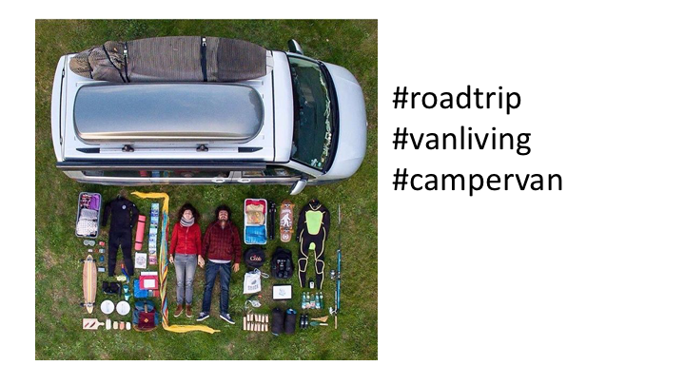

Slide 2
Yes
Notes:
C:\code\hashtag_deck\sparrowgram\Discoverable 01.png

Slide 3
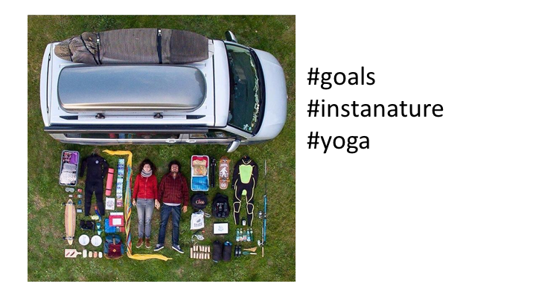

Slide 4
No
Notes:
C:\code\hashtag_deck\sparrowgram\Meh 01.png

Slide 5
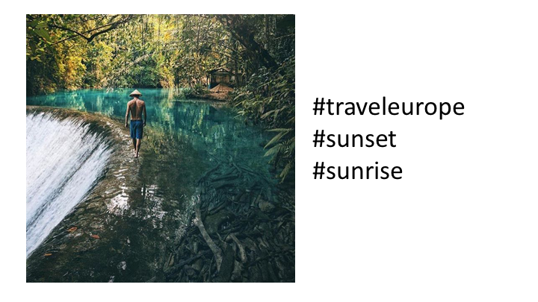

Slide 6
No
Notes:
C:\code\hashtag_deck\sparrowgram\Meh 04.png

Slide 7
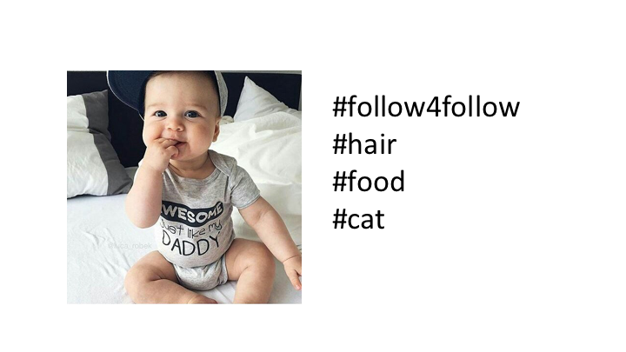

Slide 8
No
Notes:
C:\code\hashtag_deck\sparrowgram\Meh 06.png

Slide 9
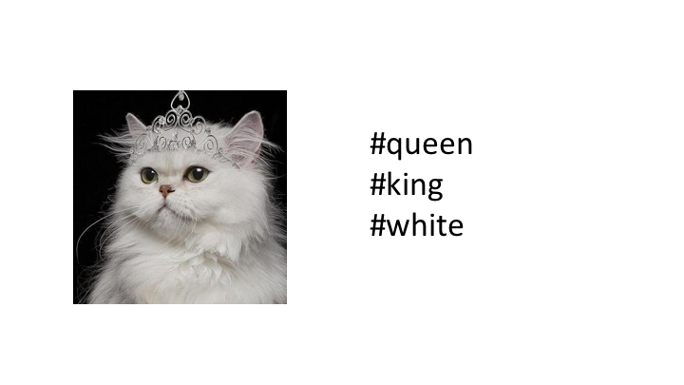

Slide 10
No
Notes:
C:\code\hashtag_deck\sparrowgram\Meh 08.png

Slide 11
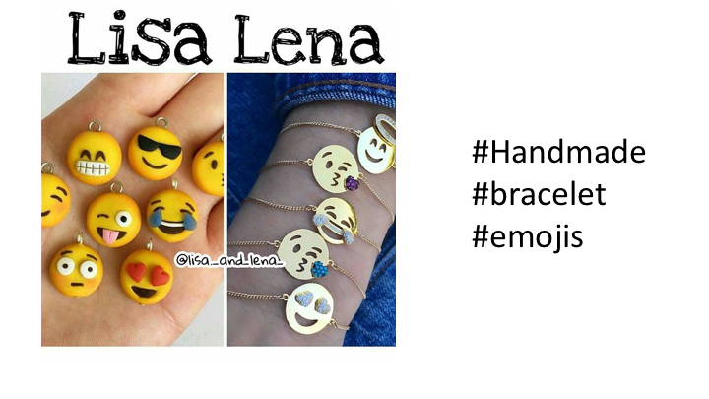

Slide 12
Yes
Notes:
C:\code\hashtag_deck\sparrowgram\Discoverable 02.png

Slide 13
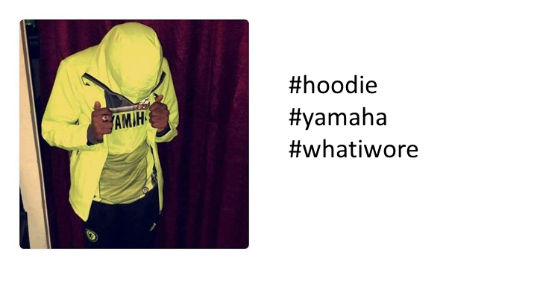

Slide 14
Yes
Notes:
C:\code\hashtag_deck\sparrowgram\Discoverable 03.png

Slide 15


Slide 16
No
Notes:
C:\code\hashtag_deck\sparrowgram\Meh 09.png

Slide 17


Slide 18
Yes
Notes:
C:\code\hashtag_deck\sparrowgram\Discoverable 04.png

Slide 19
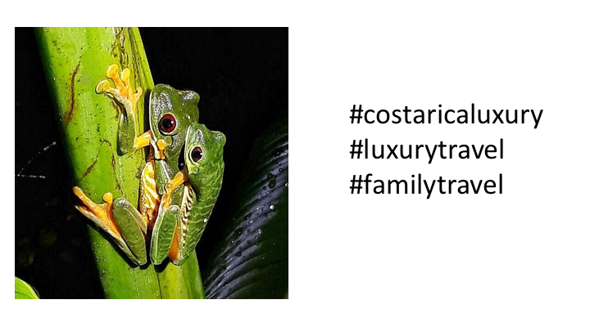

Slide 20
No
Notes:
C:\code\hashtag_deck\sparrowgram\Meh 10.png

Slide 21
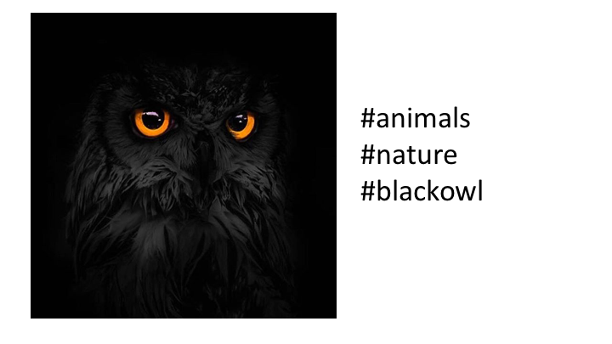

Slide 22
Yes
Notes:
C:\code\hashtag_deck\sparrowgram\Discoverable 05.png

Slide 23
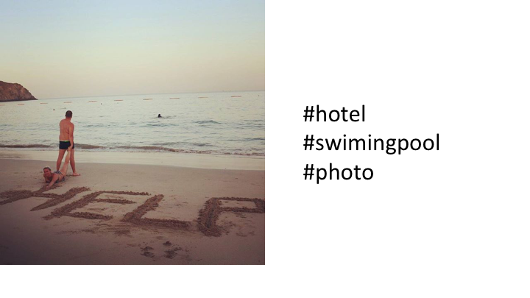

Slide 24
No
Notes:
C:\code\hashtag_deck\sparrowgram\Meh 14.png

Slide 25
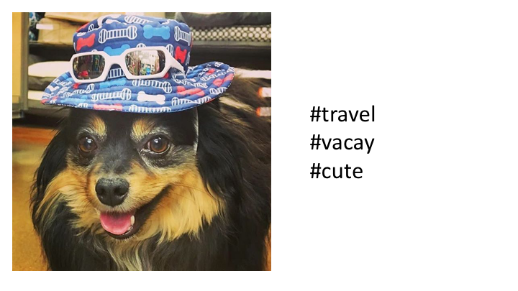

Slide 26
No
Notes:
C:\code\hashtag_deck\sparrowgram\Meh 16.png

Slide 27
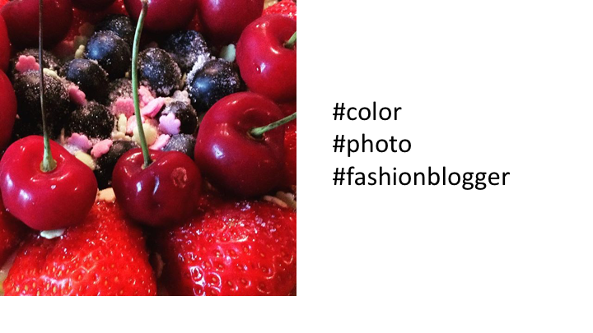

Slide 28
No
Notes:
C:\code\hashtag_deck\sparrowgram\Meh 18.png

Slide 29


Slide 30
No
Notes:
C:\code\hashtag_deck\sparrowgram\Meh 19.png

Slide 31


Slide 32
Yes
Notes:
C:\code\hashtag_deck\sparrowgram\Discoverable 06.png

Slide 33
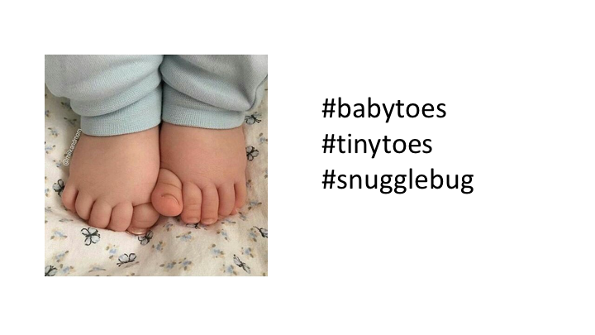

Slide 34
Yes
Notes:
C:\code\hashtag_deck\sparrowgram\Discoverable 07.png

Slide 35
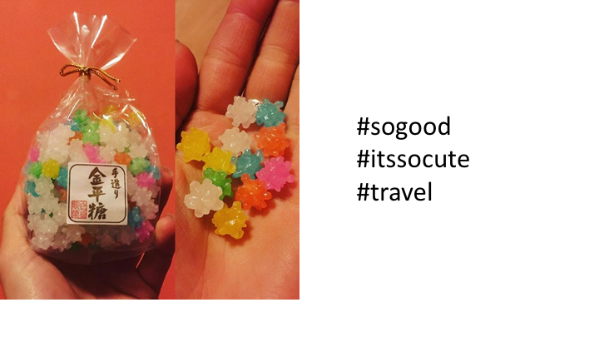

Slide 36
No
Notes:
C:\code\hashtag_deck\sparrowgram\Meh 20.png

Slide 37
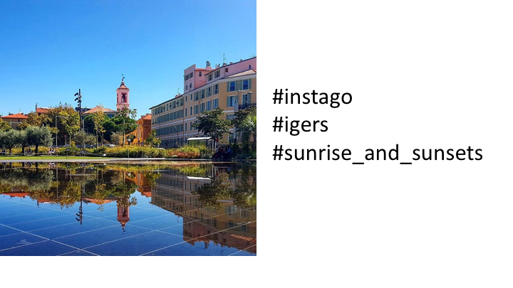

Slide 38
No
Notes:
C:\code\hashtag_deck\sparrowgram\Meh 21.png

Slide 39
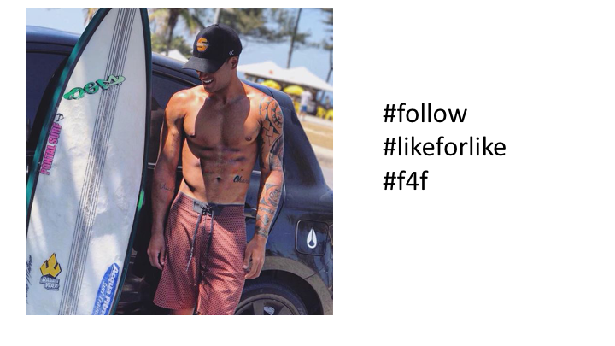

Slide 40
No
Notes:
C:\code\hashtag_deck\sparrowgram\Meh 23.png

Slide 41


Slide 42
No
Notes:
C:\code\hashtag_deck\sparrowgram\Meh 25.png

Slide 43
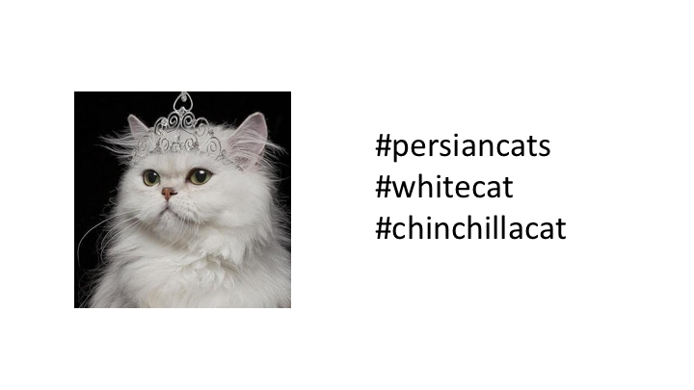

Slide 44
Yes
Notes:
C:\code\hashtag_deck\sparrowgram\Discoverable 08.png

Slide 45
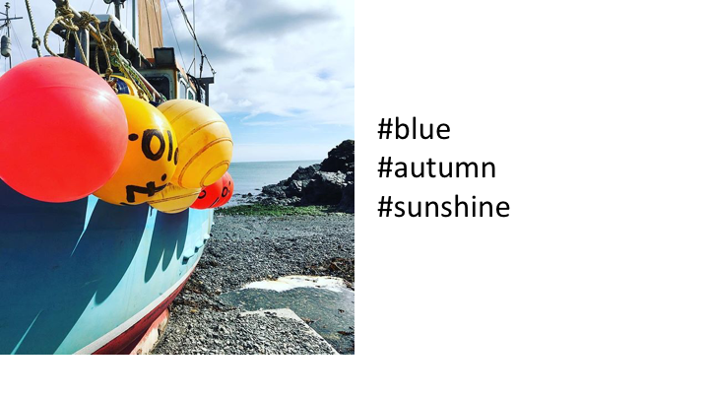

Slide 46
No
Notes:
C:\code\hashtag_deck\sparrowgram\Meh 26.png

Slide 47
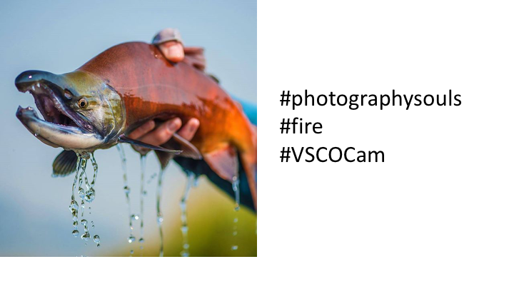

Slide 48
No
Notes:
C:\code\hashtag_deck\sparrowgram\Meh 27.png

Slide 49
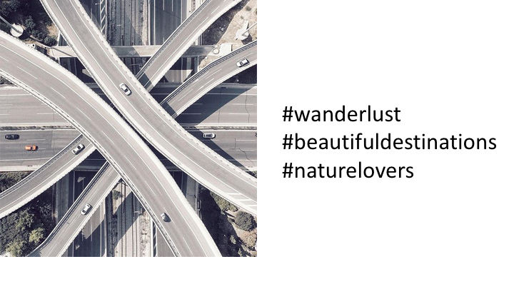

Slide 50
No
Notes:
C:\code\hashtag_deck\sparrowgram\Meh 29.png

Slide 51


Slide 52
Yes
Notes:
C:\code\hashtag_deck\sparrowgram\Discoverable 09.png

Slide 53
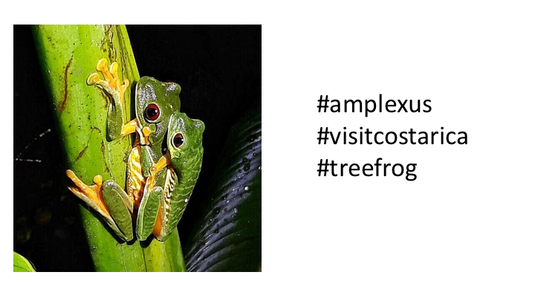

Slide 54
Yes
Notes:
C:\code\hashtag_deck\sparrowgram\Discoverable 10.png

Slide 55


Slide 56
Yes
Notes:
C:\code\hashtag_deck\sparrowgram\Discoverable 11.png

Slide 57
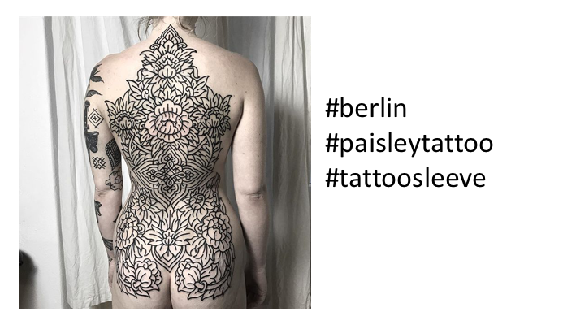

Slide 58
No
Notes:
C:\code\hashtag_deck\sparrowgram\Meh 30.png

Slide 59
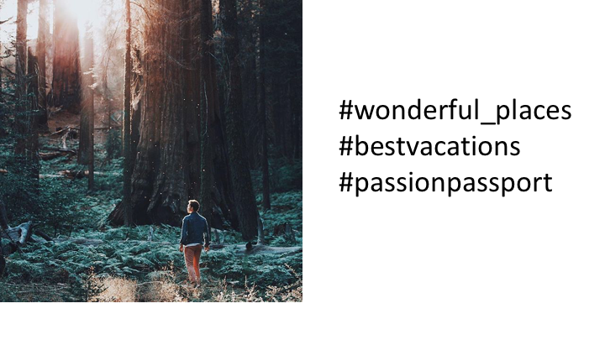

Slide 60
No
Notes:
C:\code\hashtag_deck\sparrowgram\Meh 31.png

Slide 61
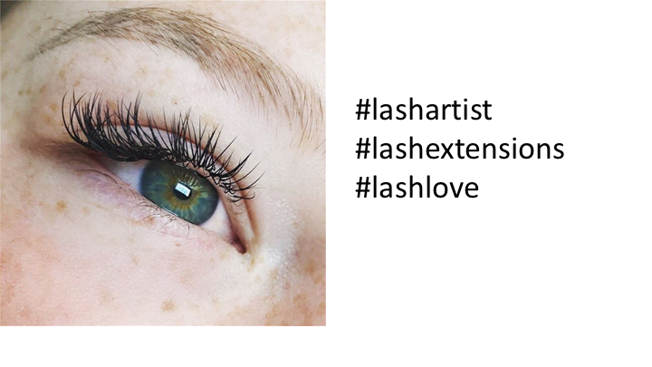

Slide 62
Yes
Notes:
C:\code\hashtag_deck\sparrowgram\Discoverable 12.png

Slide 63
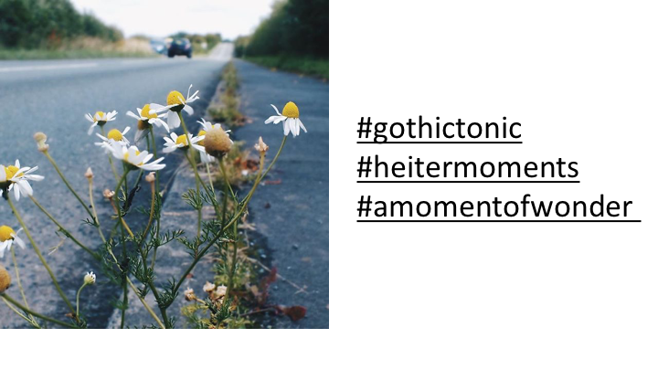

Slide 64
No
Notes:
C:\code\hashtag_deck\sparrowgram\Meh 32.png

Slide 65
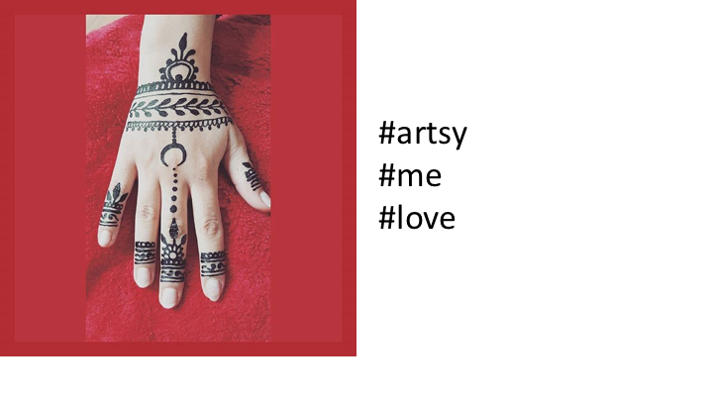

Slide 66
No
Notes:
C:\code\hashtag_deck\sparrowgram\Meh 33.png

Slide 67
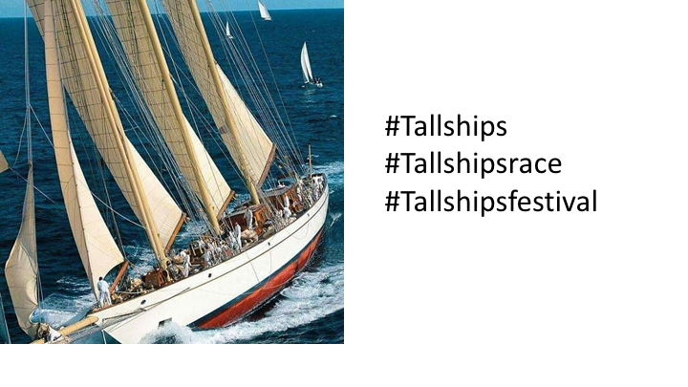

Slide 68
Yes
Notes:
C:\code\hashtag_deck\sparrowgram\Discoverable 13.png

Slide 69
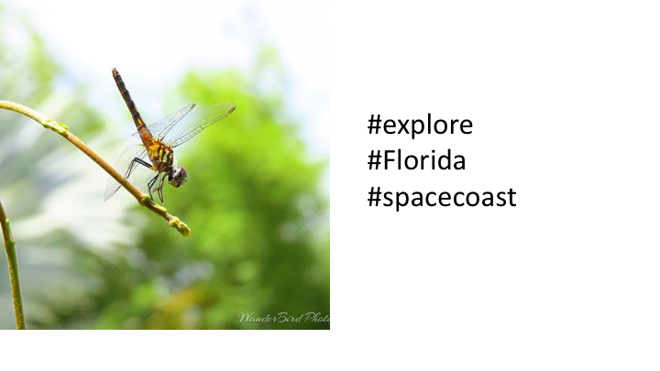

Slide 70
No
Notes:
C:\code\hashtag_deck\sparrowgram\Meh 34.png

Slide 71
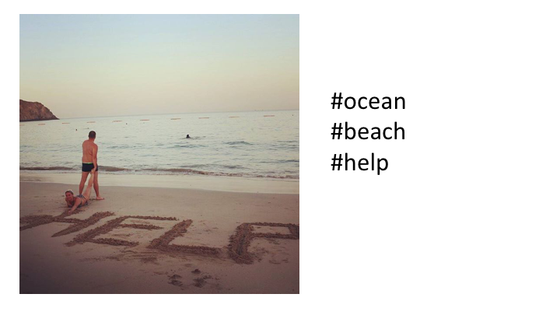

Slide 72
Yes
Notes:
C:\code\hashtag_deck\sparrowgram\Discoverable 14.png

Slide 73
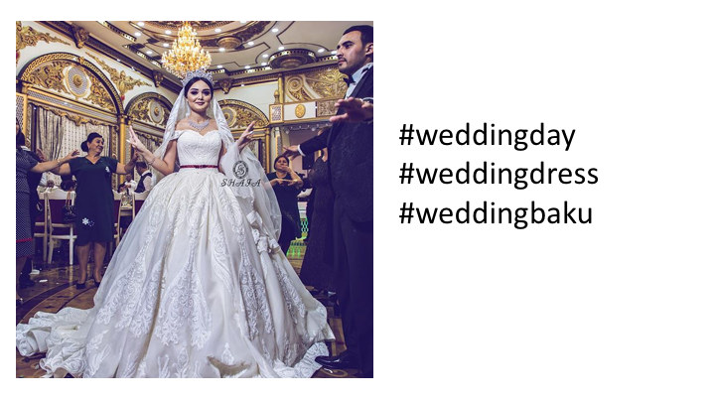

Slide 74
Yes
Notes:
C:\code\hashtag_deck\sparrowgram\Discoverable 15.png

Slide 75
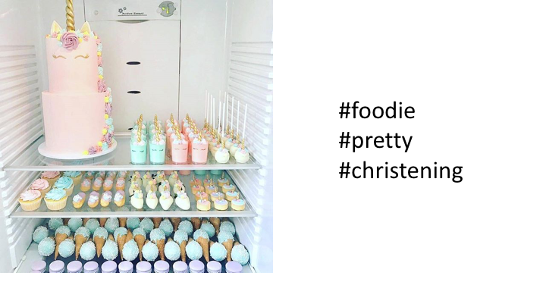

Slide 76
No
Notes:
C:\code\hashtag_deck\sparrowgram\Meh 35.png

Slide 77
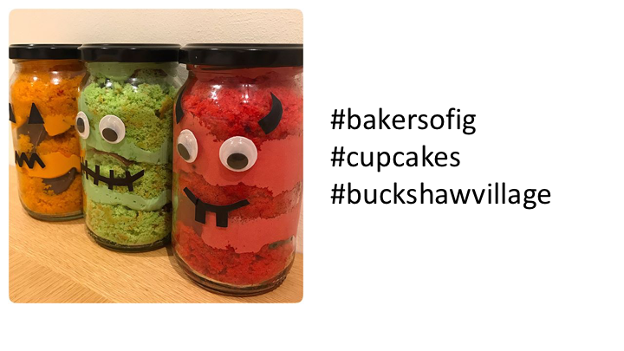

Slide 78
No
Notes:
C:\code\hashtag_deck\sparrowgram\Meh 36.png

Slide 79
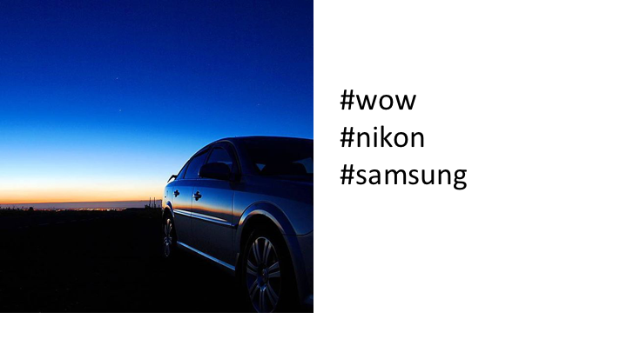

Slide 80
No
Notes:
C:\code\hashtag_deck\sparrowgram\Meh 37.png

Slide 81
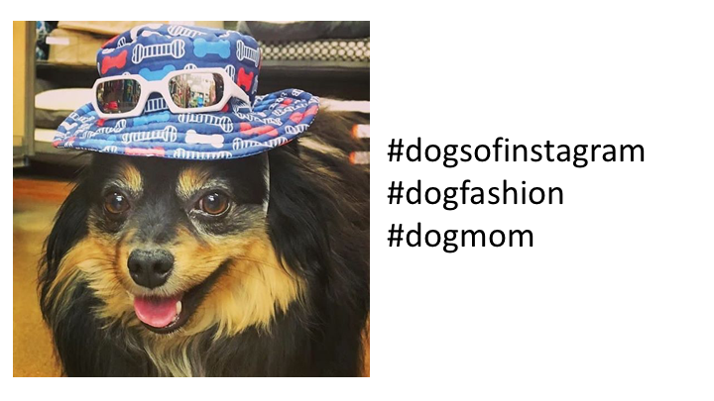

Slide 82
Yes
Notes:
C:\code\hashtag_deck\sparrowgram\Discoverable 16.png

Slide 83
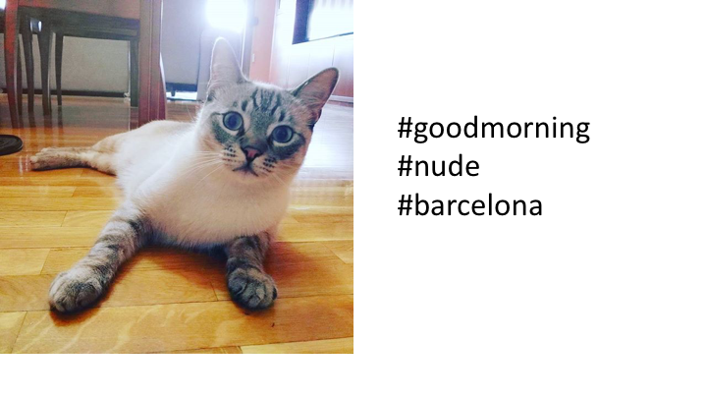

Slide 84
No
Notes:
C:\code\hashtag_deck\sparrowgram\Meh 38.png

Slide 85


Slide 86
Yes
Notes:
C:\code\hashtag_deck\sparrowgram\Discoverable 17.png

Slide 87
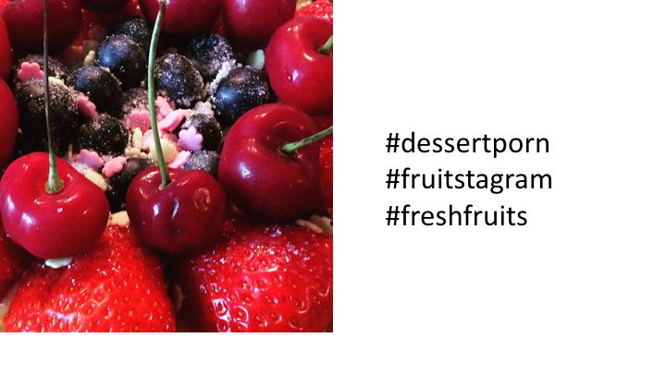

Slide 88
Yes
Notes:
C:\code\hashtag_deck\sparrowgram\Discoverable 18.png

Slide 89
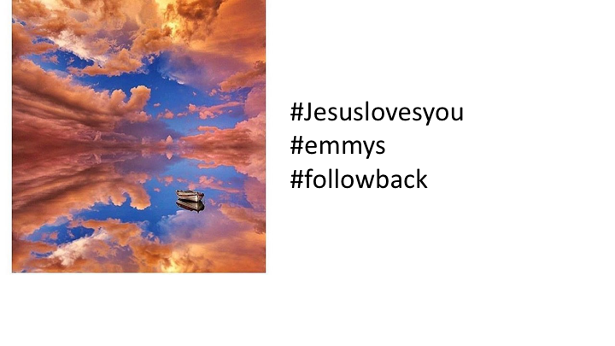

Slide 90
No
Notes:
C:\code\hashtag_deck\sparrowgram\Meh 39.png

Slide 91


Slide 92
Yes
Notes:
C:\code\hashtag_deck\sparrowgram\Discoverable 19.png

Slide 93


Slide 94
Yes
Notes:
C:\code\hashtag_deck\sparrowgram\Discoverable 20.png

Slide 95
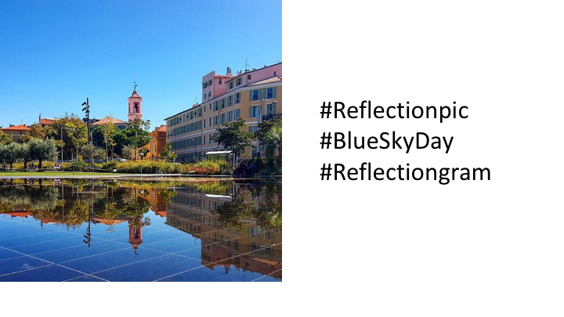

Slide 96
Yes
Notes:
C:\code\hashtag_deck\sparrowgram\Discoverable 21.png

Slide 97
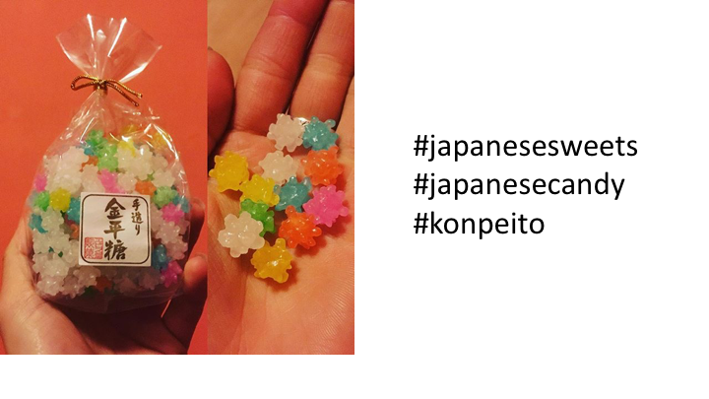

Slide 98
Yes
Notes:
C:\code\hashtag_deck\sparrowgram\Discoverable 22.png

Slide 99
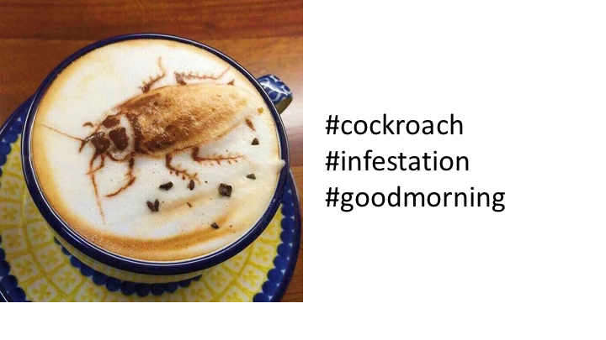

Slide 100
No
Notes:
C:\code\hashtag_deck\sparrowgram\Meh 40.png

Slide 101
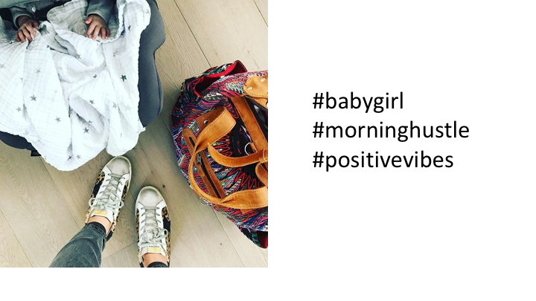

Slide 102
No
Notes:
C:\code\hashtag_deck\sparrowgram\Meh 41.png

Slide 103


Slide 104
Yes
Notes:
C:\code\hashtag_deck\sparrowgram\Discoverable 23.png

Slide 105


Slide 106
Yes
Notes:
C:\code\hashtag_deck\sparrowgram\Discoverable 24.png

Slide 107
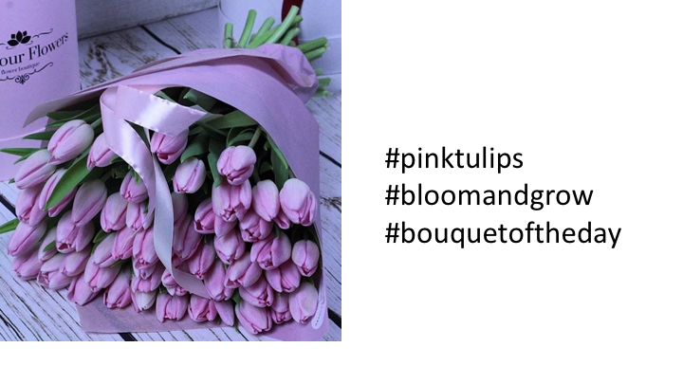

Slide 108
Yes
Notes:
C:\code\hashtag_deck\sparrowgram\Discoverable 25.png

Slide 109
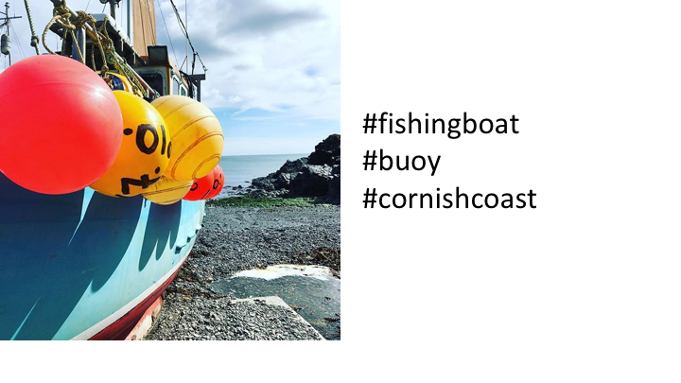

Slide 110
Yes
Notes:
C:\code\hashtag_deck\sparrowgram\Discoverable 26.png

Slide 111
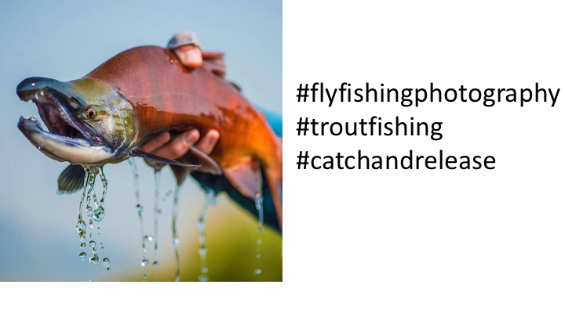

Slide 112
Yes
Notes:
C:\code\hashtag_deck\sparrowgram\Discoverable 27.png

Slide 113
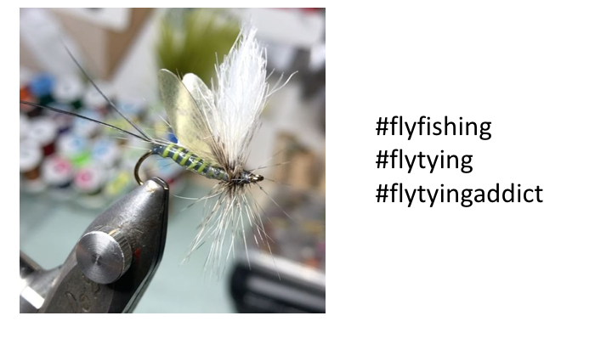

Slide 114
Yes
Notes:
C:\code\hashtag_deck\sparrowgram\Discoverable 28.png

Slide 115


Slide 116
No
Notes:
C:\code\hashtag_deck\sparrowgram\Meh 42.png

Slide 117


Slide 118
No
Notes:
C:\code\hashtag_deck\sparrowgram\Meh 43.png

Slide 119
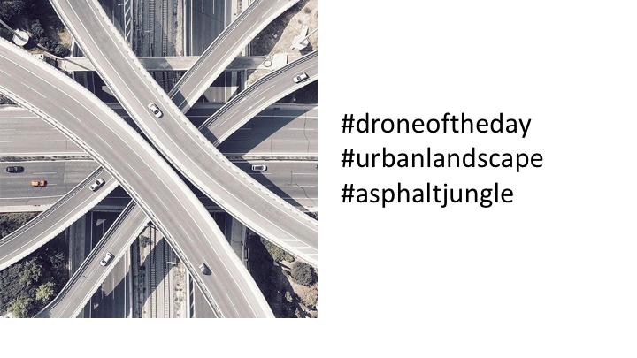

Slide 120
Yes
Notes:
C:\code\hashtag_deck\sparrowgram\Discoverable 29.png

Slide 121
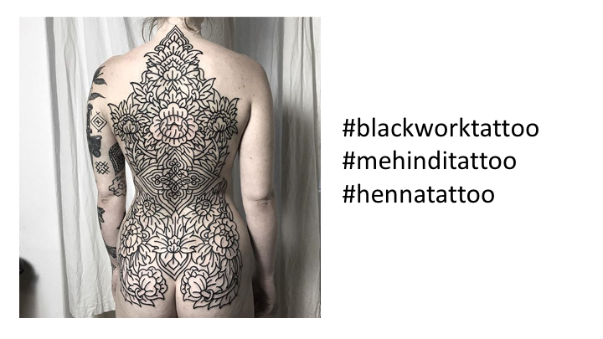

Slide 122
Yes
Notes:
C:\code\hashtag_deck\sparrowgram\Discoverable 30.png

Slide 123


Slide 124
No
Notes:
C:\code\hashtag_deck\sparrowgram\Meh 44.png

Slide 125
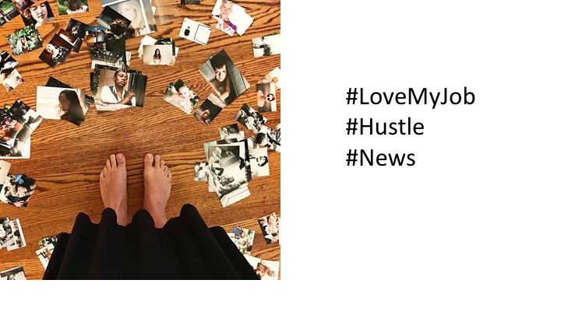

Slide 126
No
Notes:
C:\code\hashtag_deck\sparrowgram\Meh 45.png

Slide 127
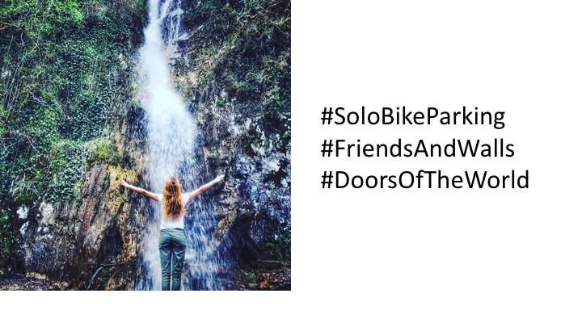

Slide 128
No
Notes:
C:\code\hashtag_deck\sparrowgram\Meh 46.png

Slide 129
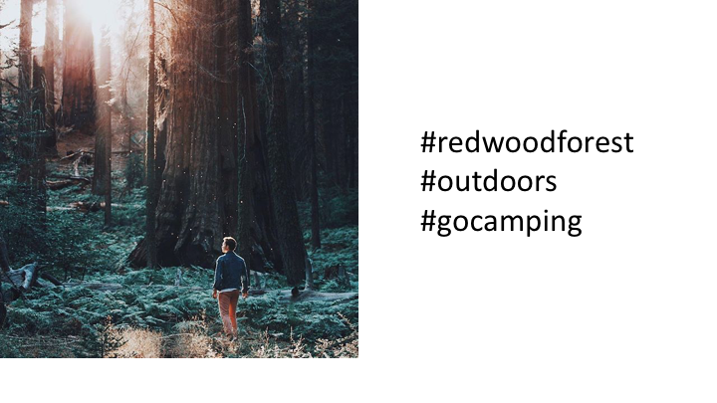

Slide 130
Yes
Notes:
C:\code\hashtag_deck\sparrowgram\Discoverable 31.png

Slide 131


Slide 132
Yes
Notes:
C:\code\hashtag_deck\sparrowgram\Discoverable 32.png

Slide 133


Slide 134
No
Notes:
C:\code\hashtag_deck\sparrowgram\Meh 47.png

Slide 135


Slide 136
Yes
Notes:
C:\code\hashtag_deck\sparrowgram\Discoverable 33.png

Slide 137


Slide 138
Yes
Notes:
C:\code\hashtag_deck\sparrowgram\Discoverable 34.png

Slide 139


Slide 140
Yes
Notes:
C:\code\hashtag_deck\sparrowgram\Discoverable 35.png

Slide 141


Slide 142
Yes
Notes:
C:\code\hashtag_deck\sparrowgram\Discoverable 36.png

Slide 143


Slide 144
No
Notes:
C:\code\hashtag_deck\sparrowgram\Meh 48.png

Slide 145


Slide 146
Yes
Notes:
C:\code\hashtag_deck\sparrowgram\Discoverable 37.png

Slide 147


Slide 148
Yes
Notes:
C:\code\hashtag_deck\sparrowgram\Discoverable 38.png

Slide 149


Slide 150
No
Notes:
C:\code\hashtag_deck\sparrowgram\Meh 49.png

Slide 151


Slide 152
Yes
Notes:
C:\code\hashtag_deck\sparrowgram\Discoverable 39.png

Slide 153


Slide 154
Yes
Notes:
C:\code\hashtag_deck\sparrowgram\Discoverable 40.png

Slide 155


Slide 156
Yes
Notes:
C:\code\hashtag_deck\sparrowgram\Discoverable 41.png

Slide 157


Slide 158
Yes
Notes:
C:\code\hashtag_deck\sparrowgram\Discoverable 42.png

Slide 159


Slide 160
Yes
Notes:
C:\code\hashtag_deck\sparrowgram\Discoverable 43.png

Slide 161


Slide 162
Yes
Notes:
C:\code\hashtag_deck\sparrowgram\Discoverable 44.png

Slide 163


Slide 164
Yes
Notes:
C:\code\hashtag_deck\sparrowgram\Discoverable 45.png

Slide 165


Slide 166
Yes
Notes:
C:\code\hashtag_deck\sparrowgram\Discoverable 46.png

Slide 167


Slide 168
Yes
Notes:
C:\code\hashtag_deck\sparrowgram\Discoverable 48.png

Slide 169


Slide 170
No
Notes:
C:\code\hashtag_deck\sparrowgram\Meh 50.png

Slide 171


Slide 172
Yes
Notes:
C:\code\hashtag_deck\sparrowgram\Discoverable 49.png

Slide 173


Slide 174
Yes
Notes:
C:\code\hashtag_deck\sparrowgram\Discoverable 50.png

Slide 175


Slide 176
Yes
Notes:
C:\code\hashtag_deck\sparrowgram\Discoverable 51.png

Slide 177


Slide 178
No
Notes:
C:\code\hashtag_deck\sparrowgram\Meh 52.png

Slide 179


Slide 180
No
Notes:
C:\code\hashtag_deck\sparrowgram\Meh 60.png

Slide 181


Slide 182
No
Notes:
C:\code\hashtag_deck\sparrowgram\Meh 62.png

Slide 183


Slide 184
No
Notes:
C:\code\hashtag_deck\sparrowgram\Meh 64.png

Slide 185


Slide 186
No
Notes:
C:\code\hashtag_deck\sparrowgram\Meh 65.png

Slide 187


Slide 188
No
Notes:
C:\code\hashtag_deck\sparrowgram\Meh 67.png

Slide 189


Slide 190
No
Notes:
C:\code\hashtag_deck\sparrowgram\Meh 68.png

Slide 191


Slide 192
No
Notes:
C:\code\hashtag_deck\sparrowgram\Meh 77.png

Slide 193


Slide 194
No
Notes:
C:\code\hashtag_deck\sparrowgram\Meh 81.png

Slide 195


Slide 196
No
Notes:
C:\code\hashtag_deck\sparrowgram\Meh 83.png

Slide 197


Slide 198
No
Notes:
C:\code\hashtag_deck\sparrowgram\Meh 87.png

Slide 199


Slide 200
No
Notes:
C:\code\hashtag_deck\sparrowgram\Meh 88.png

